Slide 1
Info 5100 Digital Marketing Design and Programming
Prof Bugrara

Slide 2
Objectives
Learn how to extend the existing range pricing design to support solution selling with dynamic pricing driven by market and channel.
Learn how good design can make it simple to measure and monitor the impact of advertising on revenues.

Slide 3
Market bundling or Solution Selling
Define Business
Define markets
Define channels
Define market/channel combination
Manage solution catalog
Define solution bundles for different markets/channel combinations
Select products for the solution bundles
Assign price for each bundle/market/channel combination
Classify Customers in certain market/channel combination
Order solutions from the solution catalog based on customer market profile

Slide 4
Market bundling or Solution Selling
Customer logs in through a channel
System identifies customer as belonging to a specific market
New solution order is created using the market-channel combination
Solutions tailored for the market-channel combination
Order solutions from the solution catalog based on customer market profile

Slide 5
Supplier Directory
Business
Market
markets
Channels
valid channels
Solution Catalog
Channel
Supplier
Solution Offer
Market-Channel Assignment
Product Catalog
Product

Slide 6
What is a Market?
Market means a group of people that possess certain common features and characteristics such as gender, age, geography, ethnicity, profession, etc.
This allows you to understand their common needs in relation to your products and services.
Must articulate how your solution responds to their needs. This makes it easy to come up with ads (market messages) that get their attention
But ads can be expensive, so you want to know if the ads are working in attracting customers to buy. If ads are not bringing revenues then you must make changes to products or market messages.
Market
Market
Teenagers
College undergrads
Millennial
Z Generation
Seniors

Slide 7
Breaking down Markets to submarkets
submarkets
Market
Market | Submarket
Teenagers | Girls
 | Boys
College undergrads
Millennial
Z Generation
Seniors
Markets can be broken down to smaller markets for more accurate targeting of customers (with the hope for more sales). For example, teenage girls might respond differently to certain colors than boys would. That way, one might attract better response due to sharper definition of needs and wants of target customers

Slide 8
Market Class Definition
submarkets
Market
public class Market {
String name;
ArrayList<String> characteristics; //a way to describe what is that group
ArrayList<Market> submarkets;
int size;
public Market(String m) {
name = m;
characteristics = new ArrayList();
submarkets = new ArrayList();
}
:
}

Slide 9



Channel Class Definition
Channel defines the route to reach customers
Defines cost or price per unit of measure (time, size, etc.)
Can be expensive so one must be careful
Channel
Internet | TV | Magazine
Solution offer
tv
public class Channel {
String channeltype; //tv, internet,
int price;
String unitofmeasure; //per minute, length, …
public Channel(String t){
channeltype = t;
}
web
Radio
Market

Slide 10
Market Channel Assignment
Helps us learn how effective our marketing campaign over a channel
Channels
Market Channel Assignment
Market/Channel |  | web | TV
Teenagers
College undergrads
Millennial
Z Generation
Seniors
X
Markets
Y
X
Means (Teenagers, web) combination
Customers who are considered teenagers buying from us via the web
Y
Customers who are considered seniors buying from us by learning about us via TV

Slide 11
ad budget for advertising for this group over this channel goes here
Market
Market-Channel Assignment
Channel
public class MarketChannelAssignment {
Market market;
Channel channel;
int adbudget;
int targetrevenue;
public MarketChannelAssignment(Market m, Channel c){
market = m;
channel = c;
}
:
}

Slide 12
Market Channel Assignment
Market | Web |  |  | TV
 | Ad Budget ($) | Target revenue ($) | Actual Sales | Ad Budget ($) | Target ($) Revenue | Actual Sales
Teenagers | 5M | 15M | ? | 20M | 70M | ?
What is our Ad budget for advertising to teenagers over the web?
What is our target revenue for this market, channel combination?
What is our actual revenues (orders) from advertising in this market-channel combination?
And most importantly, are our ads working for this group over the web ? Since ads are expensive, we must keep track of sales revenues

Slide 13
How do we find the actual revenues in response to market over a channel?
Market/Channel | Internet |  |  | TV |  |  | magazines
 | Ad Budget ($) | Target revenue ($) | Actual Sales | Ad Budget ($) | Target ($) Revenue | Actual Sales
Teenagers | 10M | 25M | ? | 40M | 100M | ?
College undergrads | 3M | 12M | ? | 10M | 20M | ?
Millennial | 29M | 50M | ? | 2M | 4M | ?
Z Generation | 12M | 25M | ? |  |  | ?
Seniors | 2M | 3M | ? | 6M | 22M | ?

Slide 14
Submarkets sharpens the focus on details
Market | Submarket | Internet |  |  | TV
 |  | Ad Budget ($) | Target revenue ($) | Actual Sales | Ad Budget ($) | Target ($) Revenue | Actual Sales
Teenagers | Girls | 5M | 15M | ? | 20M | 70M | ?
 | Boys | 3M | 10M | ? | 20M | 30M
College undergrads |  | 3M | 12M | ? | 10M | 20M | ?
Millennial |  | 29M | 50M | ? | 2M | 4M | ?
Z Generation |  | 12M | 25M | ? |  |  | ?
Seniors |  | 2M | 3M | ? | 6M | 22M | ?

Slide 15
Business
Market
Supported markets
Supported Channels
valid channels
Channel
Link to channel
Link to market
Market-Channel Assignment
All offers in this market channel combo

Slide 16
Solution Offer
A bundled set of product selections from the product catalog and offered as a solution priced specifically for a certain target market and sold over a particular channel. The price is for the whole bundle of products. We can offer the same set of products (solution) to different audiences at different prices (based on their ability to pay--not on how much money the seller wants.
Solution Offer
Market-Channel Assignment
public class SolutionOffer {
ArrayList<Product> products;
int price;//floor, ceiling, and target ideas
MarketChannelAssignment marketchannelcomb;
public SolutionOffer(MarketChannelAssignment m){
marketchannelcomb = m;
products = new ArrayList();
}

Slide 17
Solution Catalog
Hosts and manages all solution offers for all market-channel combo
Enable the creation and update of solution offers customized to markets and channels
Capable of returning all solution offers meant for a customer in a market coming in an identified channel.
Solution Catalog
Solution Offer
Market-Channel Assignment
public class SolutionOfferCatalog {
ArrayList<SolutionOffer> solutionoffers;
public SolutionOfferCatalog() {
solutionoffers = new ArrayList();
}
public SolutionOffer newSolutionOffer(MarketChannelAssignment mca){
SolutionOffer so = new SolutionOffer(mca);
solutionoffers.add(so);
return so;
}

Slide 18
Solution Catalog
Solution Catalog
Solution Offer
Market-Channel Assignment
public class SolutionOfferCatalog {
ArrayList<SolutionOffer> solutionoffers;
public SolutionOfferCatalog(){
solutionoffers = new ArrayList();
}
public SolutionOffer newSolutionOffer(MarketChannelAssignment mca){
SolutionOffer so = new SolutionOffer(mca);
solutionoffers.add(so);
return so;
}

Slide 19
Solution Catalog
Solution Catalog
Solution Offer
Market-Channel Assignment
//this method will identify all solution offers meant for customers in a market coming in over a channel
// the app will extract the market and channel combo from the user profile and use it to pull all offers
public ArrayList<SolutionOffer> findSolutionsForMarketChannelCombo(MarketChannelAssignment mcc) {
ArrayList<SolutionOffer> foundsolutions = new ArrayList();
for (SolutionOffer so : solutionoffers) {
if (so.isOfferTargetMarketChannel(mcc) == true) {
foundsolutions.add(so);
}
//find all solution offers available in the market/channel combin
}
return foundsolutions;
}

Slide 20
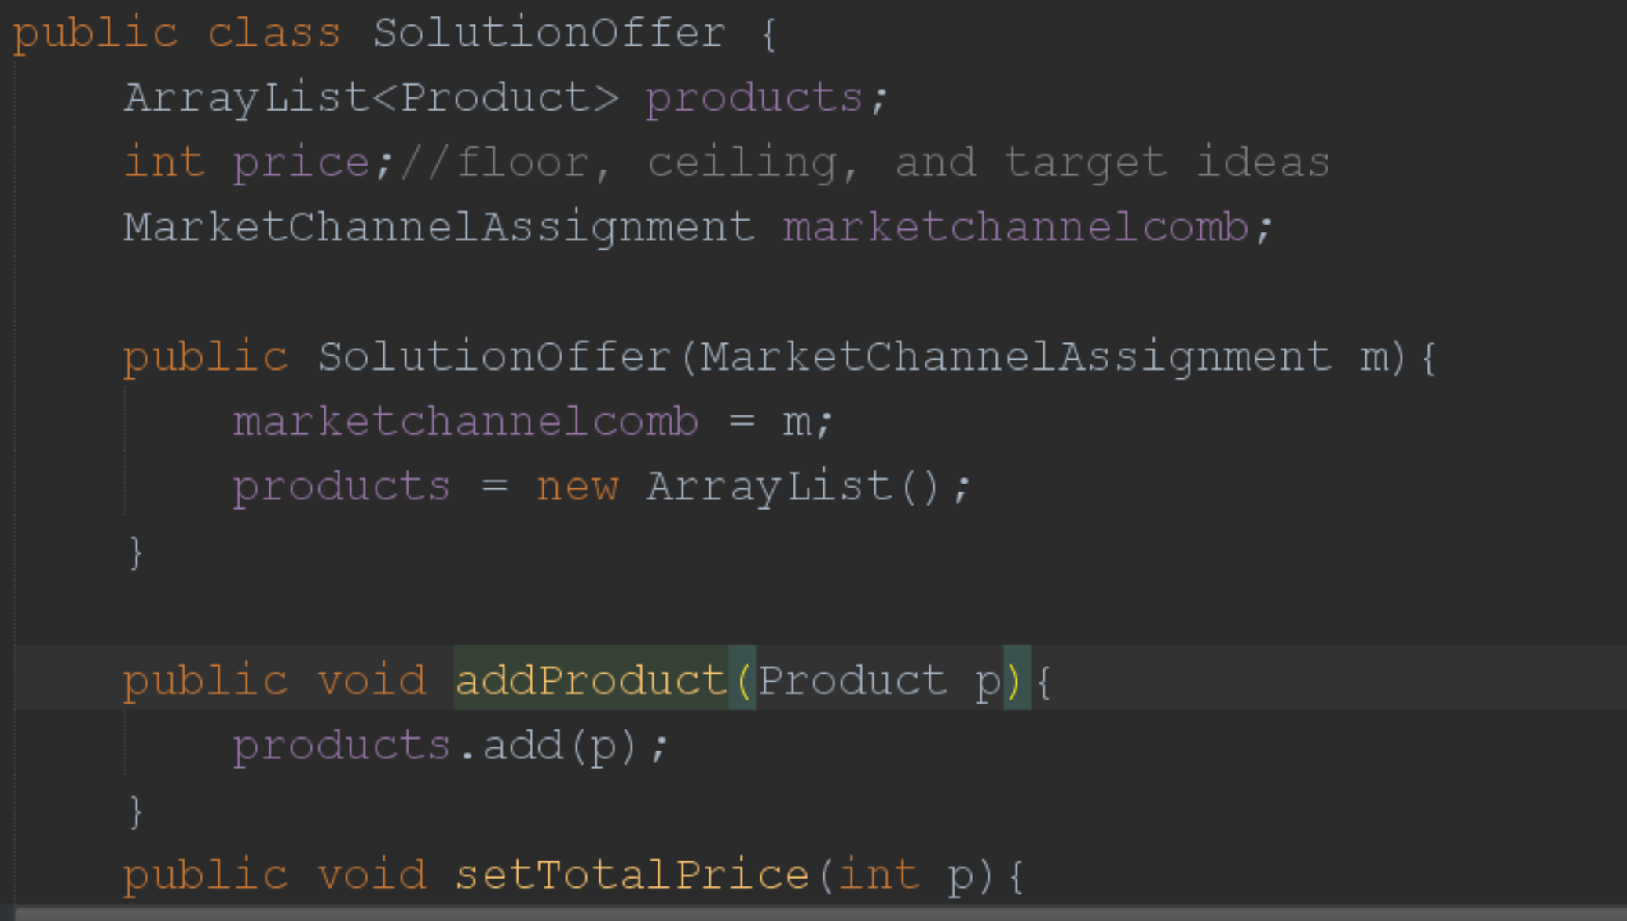
Solution Offer

Slide 21
Master Solution Order List
Business
Market
markets
Channels
supported channels
Solution Catalog
Channel
The Model
Solution Order
Solution Offer
Market-Channel Assignment
Uses the customer market and the login channel to find the right market-channel combo to use for the order
Product
Customer Profile
Customer belongs to market

Slide 22
7
1
2
Master Solution Order List
Business
Market
markets
Channels
supported channels
5
Solution Catalog
3
Channel
The Model Coding Steps
8
6
4
Solution Order
Solution Offer
Market-Channel Assignment
Uses the customer market and the login channel to find the right market-channel combo to use for the order
Product
1
1
Customer Profile
Customer belongs to market
1
Pre-existing from previous code

Slide 23
Linking the solution order to market and channel combo
Master Solution Order List
Solution Order

